Slide 1
Embedded system , Devices and Automation
Intro to Embedded Systems Domain

Slide 2

Intro to Embedded Systems Domain
Languages used in embedded systems for coding embedded devices:
1. C (99%)
Why?: Widespread usage in embedded systems due to its simplicity, efficiency, and control over hardware. [Applications: Firmware development, low-level hardware interfacing.]
2. C++
Why?: Adds object-oriented features to C, useful for larger or more complex systems.
Applications: Robotics, automotive systems, and applications requiring modular design.
3. RUST
Why?: Gaining traction for its focus on safety, concurrency, and performance.
Applications: High-reliability systems, such as medical devices or aerospace.
4. PYTHON (MicroPython/CircuitPython)
Why?: Simplifies development for prototyping and less resource-intensive applications.
Applications: IoT devices, education, and hobbyist projects.

Slide 3

1. C (99%)
Why?: Widespread usage in embedded systems due to its simplicity, efficiency, and control over hardware. [Applications: Firmware development, low-level hardware interfacing.]
2. C++
Why?: Adds object-oriented features to C, useful for larger or more complex systems.
Applications: Robotics, automotive systems, and applications requiring modular design.
3. RUST
Why?: Gaining traction for its focus on safety, concurrency, and performance.
Applications: High-reliability systems, such as medical devices or aerospace.
4. PYTHON (MicroPython/CircuitPython)
Why?: Simplifies development for prototyping and less resource-intensive applications.
Applications: IoT devices, education, and hobbyist projects.

Slide 4
1. C (99%)
Why?: Widespread usage in embedded systems due to its simplicity, efficiency, and control over hardware. [Applications: Firmware development, low-level hardware interfacing.]
2. C++
Why?: Adds object-oriented features to C, useful for larger or more complex systems.
Applications: Robotics, automotive systems, and applications requiring modular design.
3. RUST
Why?: Gaining traction for its focus on safety, concurrency, and performance.
Applications: High-reliability systems, such as medical devices or aerospace.
4. PYTHON (MicroPython/CircuitPython)
Why?: Simplifies development for prototyping and less resource-intensive applications.
Applications: IoT devices, education, and hobbyist projects.
WHAT IS AN EMBEDDED SYSTEM?
WHAT IS AN EMBEDDED SYSTEM?

Slide 5

1. C (99%)
Why?: Widespread usage in embedded systems due to its simplicity, efficiency, and control over hardware. [Applications: Firmware development, low-level hardware interfacing.]
2. C++
Why?: Adds object-oriented features to C, useful for larger or more complex systems.
Applications: Robotics, automotive systems, and applications requiring modular design.
3. RUST
Why?: Gaining traction for its focus on safety, concurrency, and performance.
Applications: High-reliability systems, such as medical devices or aerospace.
4. PYTHON (MicroPython/CircuitPython)
Why?: Simplifies development for prototyping and less resource-intensive applications.
Applications: IoT devices, education, and hobbyist projects.
WHAT IS AN EMBEDDED SYSTEM?
A combination of hardware and software designed to perform a specific function.
Examples: Microcontrollers, Smart Home Devices, Automotive Systems, Medical Equipment, etc.
CHARACTERISTICS
Real-time operation Low power consumption Compact size Cost-effective

Slide 6
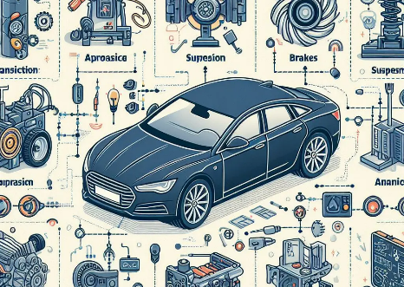





1. C (99%)
Why?: Widespread usage in embedded systems due to its simplicity, efficiency, and control over hardware. [Applications: Firmware development, low-level hardware interfacing.]
2. C++
Why?: Adds object-oriented features to C, useful for larger or more complex systems.
Applications: Robotics, automotive systems, and applications requiring modular design.
3. RUST
Why?: Gaining traction for its focus on safety, concurrency, and performance.
Applications: High-reliability systems, such as medical devices or aerospace.
4. PYTHON (MicroPython/CircuitPython)
Why?: Simplifies development for prototyping and less resource-intensive applications.
Applications: IoT devices, education, and hobbyist projects.
Automotive
Consumer Electronics
Connected vehicles, EVs, ADAS
A combination of hardware and software designed to perform a specific function.
Examples: Microcontrollers, Smart Home Devices, Automotive Systems, Medical Equipment, etc.
CHARACTERISTICS
Real-time operation Low power consumption Compact size Cost-effective
Smart appliances and wearables
WHAT IS AN EMBEDDED SYSTEM?
Statistics About Embedded Systems
Healthcare
Medical devices and diagnostics
Telecom
5G infrastructure and devices.

Slide 7
1. C (99%)
Why?: Widespread usage in embedded systems due to its simplicity, efficiency, and control over hardware. [Applications: Firmware development, low-level hardware interfacing.]
2. C++
Why?: Adds object-oriented features to C, useful for larger or more complex systems.
Applications: Robotics, automotive systems, and applications requiring modular design.
3. RUST
Why?: Gaining traction for its focus on safety, concurrency, and performance.
Applications: High-reliability systems, such as medical devices or aerospace.
4. PYTHON (MicroPython/CircuitPython)
Why?: Simplifies development for prototyping and less resource-intensive applications.
Applications: IoT devices, education, and hobbyist projects.
A combination of hardware and software designed to perform a specific function.
Examples: Microcontrollers, Smart Home Devices, Automotive Systems, Medical Equipment, etc.
CHARACTERISTICS
Real-time operation Low power consumption Compact size Cost-effective
WHAT IS AN EMBEDDED SYSTEM?
Key Applications of Embedded Systems in India:
Automotive
Telecom
Consumer Electronics
Healthcare
Connected vehicles, EVs, ADAS
5G infrastructure and devices.
Smart appliances and wearables
Medical devices and diagnostics
Our world becomes more dependent on technology, thus the integration of AI and machine learning into embedded systems continues to expand, driving innovation and economic growth in numerous industries.

Slide 8

1. C (99%)
Why?: Widespread usage in embedded systems due to its simplicity, efficiency, and control over hardware. [Applications: Firmware development, low-level hardware interfacing.]
2. C++
Why?: Adds object-oriented features to C, useful for larger or more complex systems.
Applications: Robotics, automotive systems, and applications requiring modular design.
3. RUST
Why?: Gaining traction for its focus on safety, concurrency, and performance.
Applications: High-reliability systems, such as medical devices or aerospace.
4. PYTHON (MicroPython/CircuitPython)
Why?: Simplifies development for prototyping and less resource-intensive applications.
Applications: IoT devices, education, and hobbyist projects.
A combination of hardware and software designed to perform a specific function.
Examples: Microcontrollers, Smart Home Devices, Automotive Systems, Medical Equipment, etc.
CHARACTERISTICS
Real-time operation Low power consumption Compact size Cost-effective
WHAT IS AN EMBEDDED SYSTEM?
Telecom
Consumer Electronics
Healthcare
5G infrastructure and devices.
Automotive
Smart appliances and wearables
Medical devices and diagnostics
Connected vehicles, EVs, ADAS
A Career in Embedded Systems
Our world becomes more dependent on technology, thus the integration of AI and machine learning into embedded systems continues to expand, driving innovation and economic growth in numerous industries.
Learning Embedded Systems by the following,
THREE ESSENTIAL COMPONENTS

Slide 9
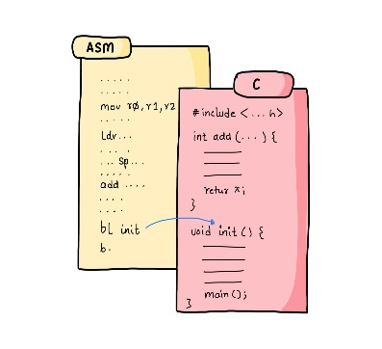
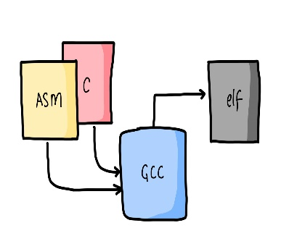
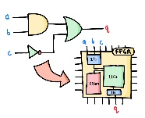
1. C (99%)
Why?: Widespread usage in embedded systems due to its simplicity, efficiency, and control over hardware. [Applications: Firmware development, low-level hardware interfacing.]
2. C++
Why?: Adds object-oriented features to C, useful for larger or more complex systems.
Applications: Robotics, automotive systems, and applications requiring modular design.
3. RUST
Why?: Gaining traction for its focus on safety, concurrency, and performance.
Applications: High-reliability systems, such as medical devices or aerospace.
4. PYTHON (MicroPython/CircuitPython)
Why?: Simplifies development for prototyping and less resource-intensive applications.
Applications: IoT devices, education, and hobbyist projects.
A combination of hardware and software designed to perform a specific function.
Examples: Microcontrollers, Smart Home Devices, Automotive Systems, Medical Equipment, etc.
CHARACTERISTICS
Real-time operation Low power consumption Compact size Cost-effective
WHAT IS AN EMBEDDED SYSTEM?
Telecom
Consumer Electronics
Healthcare
5G infrastructure and devices.
Automotive
Smart appliances and wearables
Medical devices and diagnostics
Connected vehicles, EVs, ADAS
A Career in Embedded Systems
Our world becomes more dependent on technology, thus the integration of AI and machine learning into embedded systems continues to expand, driving innovation and economic growth in numerous industries.
Learning Embedded Systems by the following,
THREE ESSENTIAL COMPONENTS
C and Assembly
Build Tools
GATES

Slide 10
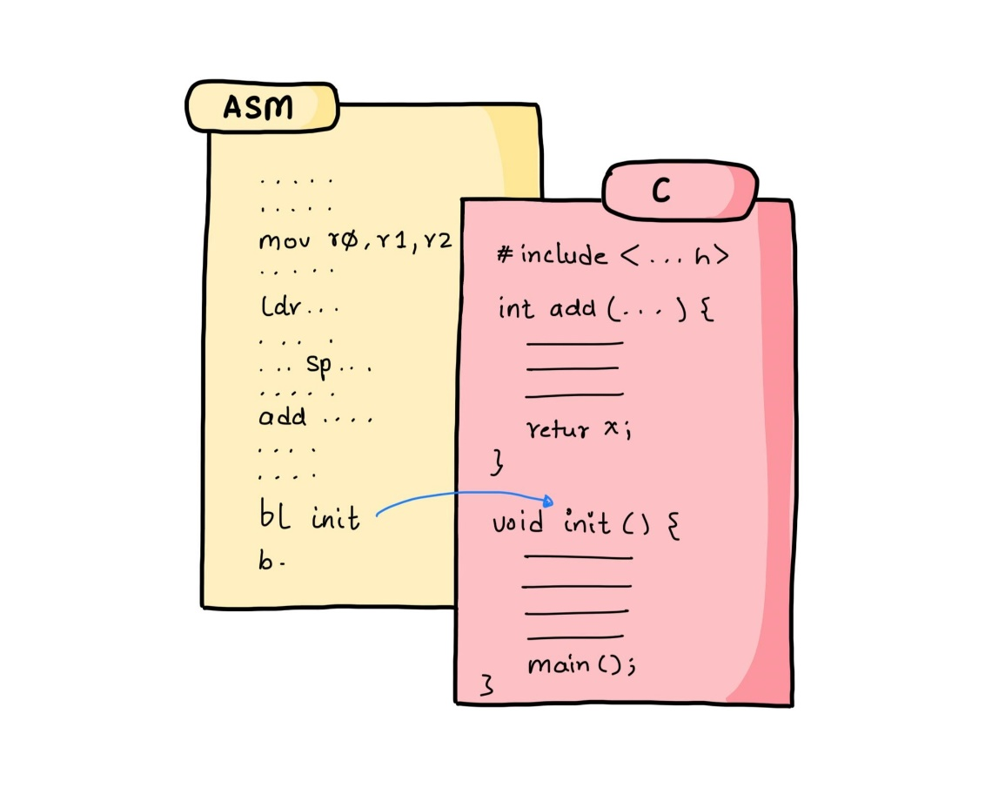
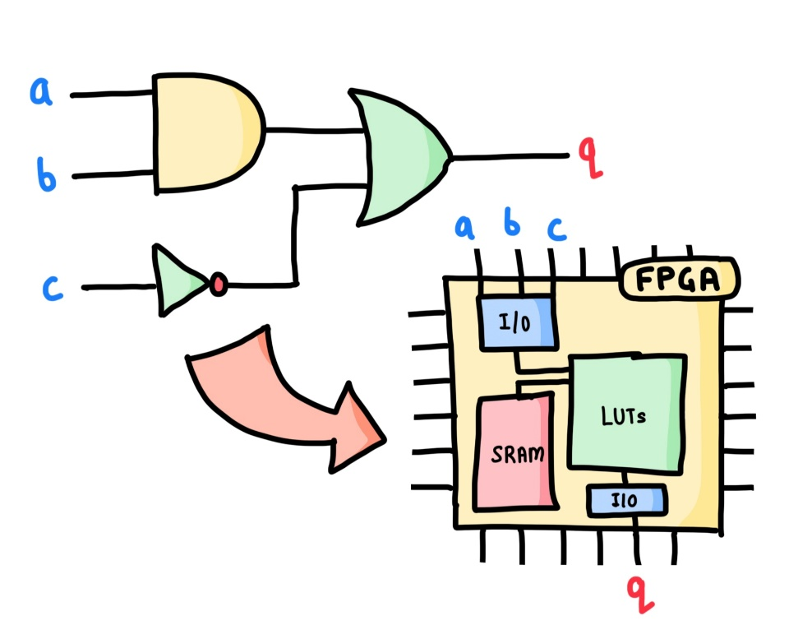

1. C (99%)
Why?: Widespread usage in embedded systems due to its simplicity, efficiency, and control over hardware. [Applications: Firmware development, low-level hardware interfacing.]
2. C++
Why?: Adds object-oriented features to C, useful for larger or more complex systems.
Applications: Robotics, automotive systems, and applications requiring modular design.
3. RUST
Why?: Gaining traction for its focus on safety, concurrency, and performance.
Applications: High-reliability systems, such as medical devices or aerospace.
4. PYTHON (MicroPython/CircuitPython)
Why?: Simplifies development for prototyping and less resource-intensive applications.
Applications: IoT devices, education, and hobbyist projects.
A combination of hardware and software designed to perform a specific function.
Examples: Microcontrollers, Smart Home Devices, Automotive Systems, Medical Equipment, etc.
CHARACTERISTICS
Real-time operation Low power consumption Compact size Cost-effective
WHAT IS AN EMBEDDED SYSTEM?
Learning Embedded Systems by the following,
THREE ESSENTIAL COMPONENTS
C and Assembly
GATES
Build Tools

